Slide 1
Quality Management (QM)
Curriculum: Introduction to S/4HANA using Global Bike

Slide 2

4.3 (June 2025)
SAP S/4HANA 2023
Fiori 3.0
Global Bike
No Prerequisites needed

Slide 3
Tim Böttcher
Babett Ruß
Beginner

Slide 4
You are able to
name functionalities of the QM module.
define the central organizational structures of the QM module.
summarize the master data which is most important for the QM module.
explain a standard QM process.

Slide 5
Functionality
Quality Planning
Quality Inspection
Quality Control
Quality Certificates
Quality Notifications
Test Equipment Management
Inspection Using Multiple Specifications
Stability Study
Control in Logistics
Archiving
Data Transfer

Slide 6
Unit Overview
QM Organizational Structure
QM Master Data
QM Processes

Slide 7
QM Organizational Structure
Client
  An independent environment in the system
Company Code
  Smallest org unit for which you can maintain a legal set of books
Plant
  Operating area or branch within a company
    Manufacturing, distribution, purchasing or maintenance facility
Storage Location
  An organizational unit allowing differentiation between the various stocks of a material in a plant

Slide 8
QM Organizational Structure
Purchasing Organization
  The buying activity for a plant takes place at the purchasing organization
  Organization unit responsible for procuring services and materials
  Negotiates conditions of the purchase with the vendors
Purchasing Group
  Key that represents the buyer or group of buyers who are responsible for certain purchasing activities
  Channel of communication for vendors

Slide 9
Global Bike Structure for Quality Management
Global Bike
Client
Global Bike Inc.
Global Bike Germany GmbH
Company
Code
Dallas
San Diego
Miami
Heidelberg
Hamburg
Plant
Raw Materials
Trading Goods
Trading Goods
Raw Materials
Trading Goods
Storage
Location
Semi-fin. Goods
Finished Goods
Finished Goods
Semi-fin. Goods
Finished Goods
Finished Goods
Miscellaneous
Miscellaneous
Finished Goods
Miscellaneous
Miscellaneous
Miscellaneous

Slide 10
Global Bike Enterprise Structure in SAP ERP (Logistics)
Shipping Point
DL00
MI00
SD00
TO00
HD00
HH00
PE00
RM00
TG00
TG00
TG00
RM00
TG00
TG00
Storage
Location
SF00
FG00
FG00
FG00
SF00
FG00
FG00
FG00
MI00
MI00
MI00
FG00
MI00
MI00
MI00
MI00
Central Purchasing Organization (global) GL00
Purchasing Org. US00
CA00
PO DE00
AU00
Purchasing Group North America
N00
PGr Europe
E00
Asia
A00
Dallas
DL00
Miami
MI00
S. Diego
SD00
Toronto
TO00
Heidelb.
HD00
Hamburg
HH00
Perth
PE00
Plant
CC US00
CA00
CC DE00
AU00
Company Code
Client Global Bike
Notes:
Organizational units displayed in grey are not yet implemented, but are already planned in Global Bike.

Slide 11
Agenda
QM Organizational Structure
QM Master Data
QM Processes

Slide 12
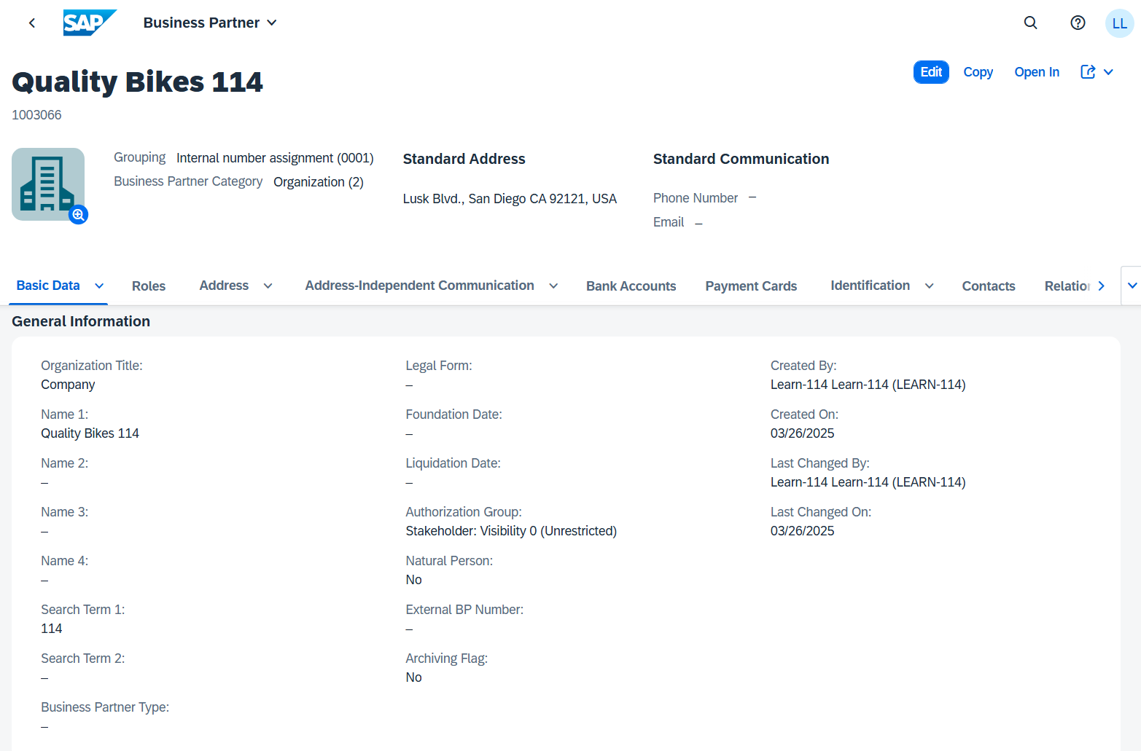
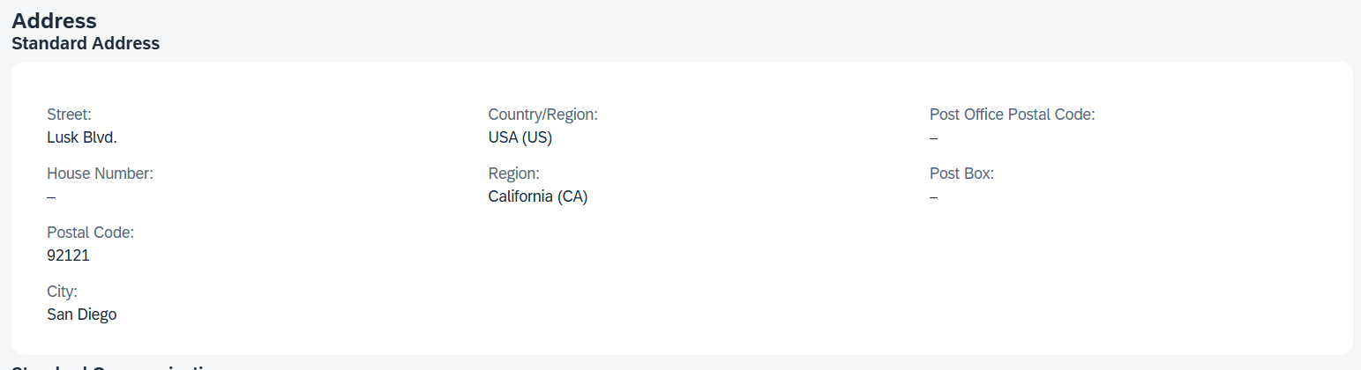
Customer Master Data
Customer Master
  Contains all of the information necessary for processing orders, deliveries, invoices and customer payment
  Every customer MUST have a master record
Created by Sales Area
  Sales Organization
  Distribution Channel
  Division

Slide 13
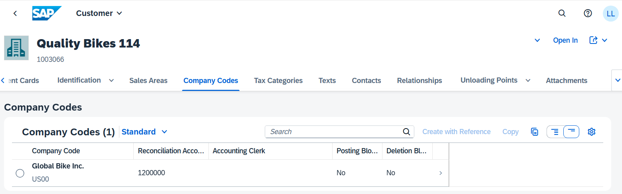
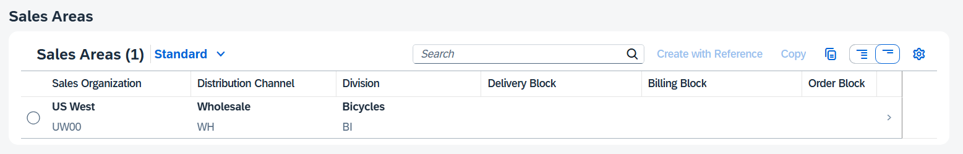
Customer Master Data
The customer master information is divided into 3 areas:
  General Data
  Company Code Data
  Sales Area Data

Slide 14
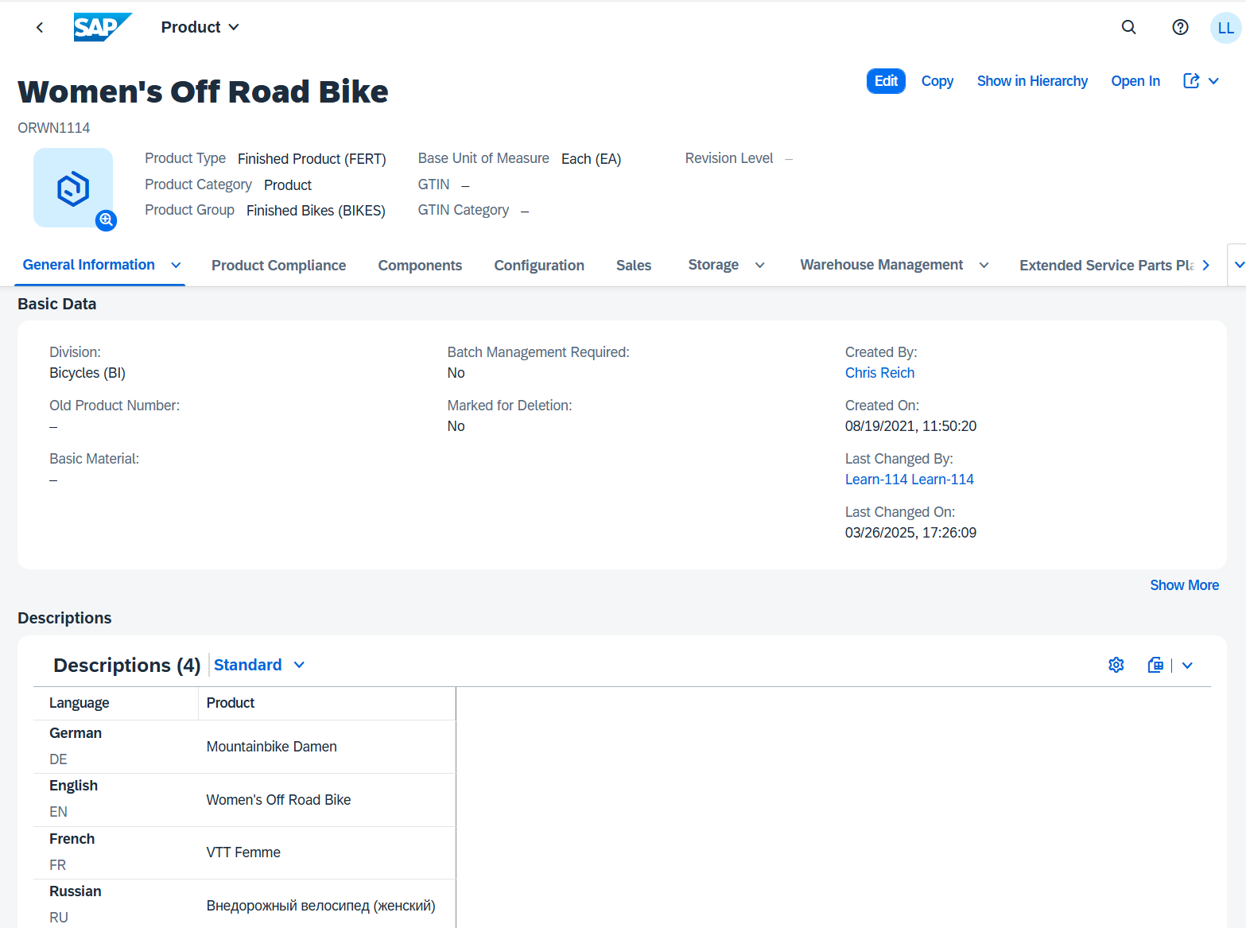
Material Master Data
Material Master
  Contains all the information a company needs to manage about a material
  It is used by most components within the SAP system
    Sales and Distribution
    Materials Management
    Production
    Plant Maintenance
    Accounting/Controlling
    Quality Management
  Material master data is stored in functional segments called Views

Slide 15
Material Master Views
Sales Data
Basic Data
Purchasing Data
Material Master
Mat. Plan. Data
Forecasting Data
Storage Data
Controlling Data
Quality Data
Accounting Data

Slide 16
Material Master
General Information relevant for the entire organization:
Name
Weight
Unit of Measure
Client XXX
Sales specific information:
Delivering Plant
Loading Grp
Storage Location specific information:
Stock Qty
Sales Org. UW00
Storage Loc. FG00
Sales Org. UE00
Storage Loc. TG00
Notes:
All of this together makes up the Master Record for a Material.

Slide 17
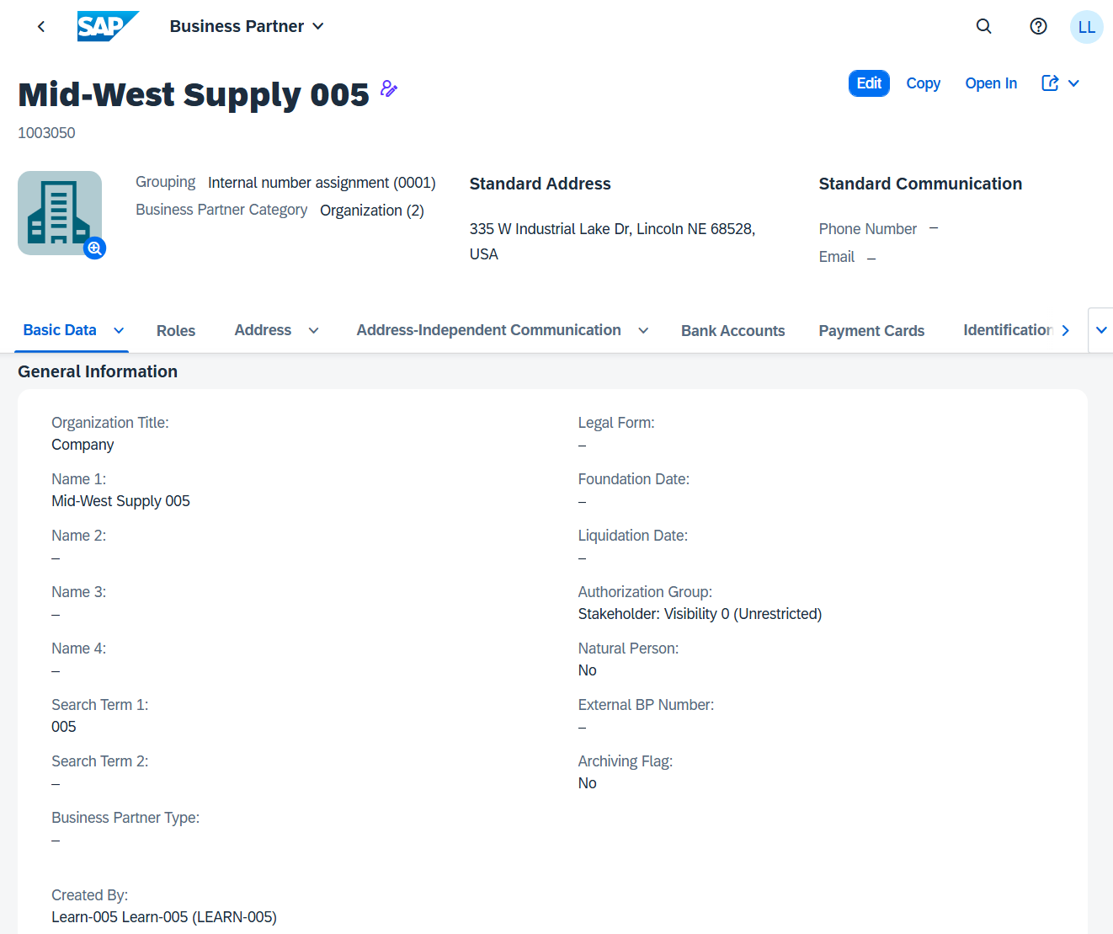
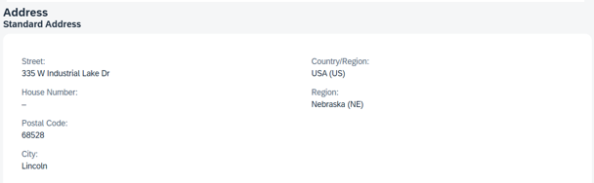
Vendor Master Data
Vendor Master
  Contains all the necessary information needed to business with an
  external supplier
  Used and maintained primarily by the Purchasing and Accounting
  Departments
  Every vendor MUST have a master record

Slide 18
Vendor Master Views
Client Level
  Address
  Vendor Number
  Preferred Communication
Company Code Data
  Reconciliation Account
  Terms of Payment
  Bank Account
Purchase Org Data
  Purchasing Currency
  Salesman’s Name
  Vendor Partners
General Data
Company Code Data
Financial Accounting (FI)
Purchasing Data
Materials Mgmt (MM)

Slide 19
Vendor Master
General Information relevant for the entire organization:
Name
Address
Communication
Client XXX
Company Code specific information:
Acc. Mgmt
Payment
Bank
Purch. Organization specific information:
Incoterms Currency
Company Code US00
Purch. Org. US00
Company Code DE00
Purch. Org. DE00

Slide 20
Agenda
QM Organizational Structure
QM Master Data
QM Processes
  Quality Management
  Quality Management in Procurement
  Quality Management in SD

Slide 21
QM Process
Quality Info. Record
Inspection Lot
Inspection Plan
Perform Inspection
Usage Decision

Slide 22
Quality Information Record
If a quality assurance agreement or vendor release is required for a material, a Quality Info. Record must be created
Determines how a material can be processed further
when a quotation or purchase order is created, the system checks whether a quality info record is required and available for the combination of material and vendor
System also checks, whether the vendor and material-vendor combination is blocked or released for quotations, purchase orders and/or goods receipt

Slide 23
Inspection Plan
Can be created for different uses as model inspection, carrying out an audit, preliminary series inspection, goods receipt inspection, goods issue inspection, inspection of stock transfers, inspections in repetitive manufacturing
Defines which characteristics are to be inspected in each inspection operation and which test equipment is to be used in the inspection
Several materials can be assigned to an inspection plan
Several inspection plans with different inspection operations or inspection characteristics can be created for a material or combination of material, vendor and manufacturer, or material and customer

Slide 24
Inspection Lot
Request to a plant to inspect a specific quantity of material or one or more pieces of equipment or functional locations
Documented by an inspection lot record
Used to record, process and manage information for a quality inspection
Whenever materials are moved from on place to another under certain conditions, the QM component can automatically create inspection lots
The system can also create an inspection lot automatically if a delivery is created in the SD component for a inspection-relevant material
Can be created automatically or manually

Slide 25
Perform Inspection
Inspection of sample units of the inspection lot
Number of non-conforming sample units entered in the SAP System

Slide 26
Usage Decision
Confirms that all physical samples have been valuated and the inspection has been completed
Specifies whether the goods in the inspection lot have been accepted or rejected for use
Inspection lot stock can be posted to different stocks
  Unrestricted use
  Scrap
  Sample usage
  Blocked stock

Slide 27
QM Process in Procurement
Quality Info. Record
Receiving Material
Inspection Lot
Purchase Order
Inspection Plan
Perform Inspection
Usage Decision

Slide 28
Quality Management in SD
Inspection Plan
Quality Info Record
Goods Issue
Inspection Lot
Perform
Inspection
Usage Decision
Goods Receipt
Sales Order
Invoice
Outbound Delivery

Slide 29
SAP QM Module Integration
High integration in other SAP modules including:
  SAP MM
    e.g. maintain quality agreements
  SAP SD
    e.g. quality information related to customers
  SAP PP
    e.g. perform inspection planning
  SAP CO
    e.g. integrate SAP QM with controlling process

